Slide 1
Success
beyond Grades
Does Singapore’s education system foster
the holistic development of a child?
By Ashley Bai [P2237871]

Slide 2
Welcome!
Hi! I’m Jane. I am considering to move to Singapore for the sake of my children’s education, as I have heard many good things about Singapore’s education system, where they develop children holistically.
Is it true that Singapore’s education system develops all-rounded students?

Slide 3
01
Government Development Expenditure on Education
How does the government divide the development expenditure on education now as compared to the past?

Slide 4
The Nature of Dataset 1
YEAR
1985 to 2020
YEAR
1985 to 2020, was not edited.
TYPE OF EDUCATIONAL
INSTITUTIONS
ITE, JCs/Centralised Institute, NIE, POLYs, Primary, Secondary, Universities
TYPE OF EDUCATIONAL
INSTITUTIONS
ITE, JCs/Centralised Institute, NIE, POLYs, Primary, Secondary, Universities
DEVELOPMENT EXPENDITURE
Values remained the same, was not edited.
DEVELOPMENT EXPENDITURE
Values remained the same, was not edited.
Old Dataset
New Dataset
After data wrangling/cleaning…

Slide 5
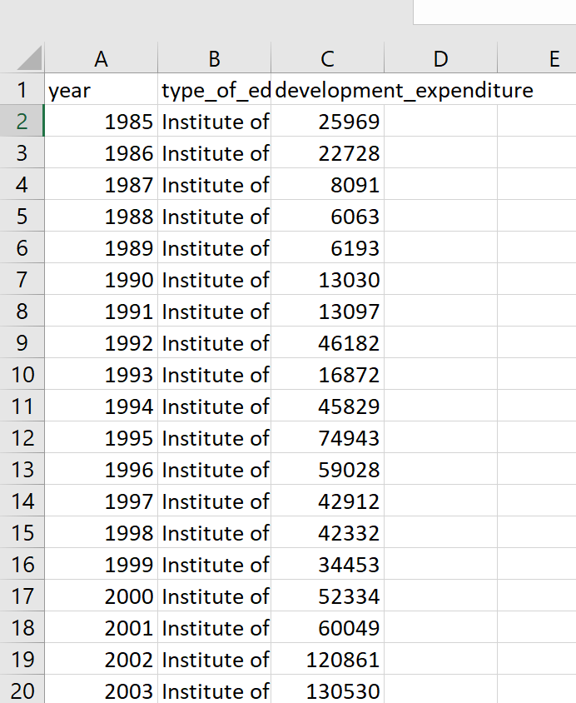
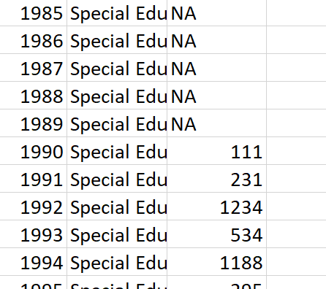
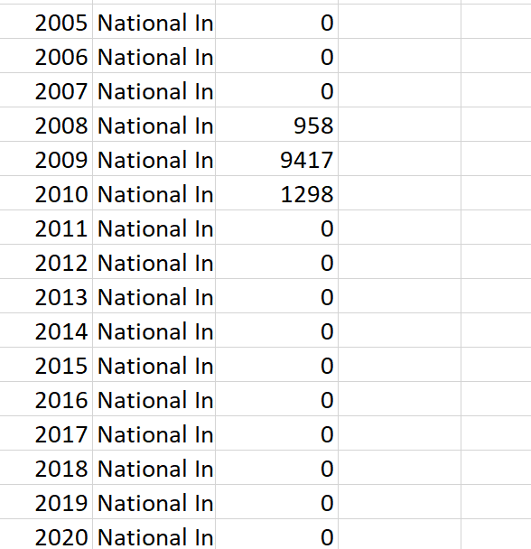
Cleaned/Wrangled Data by:
I used Microsoft Excel to edit the given dataset.
I only used the type of education institution that are related to my children (aged 9-17)
I removed the data of Special Education and NIE as not only did they contain NA/null values, but they are also not needed in my analysis.
MOE HQ and others are also not needed in my analysis.
I filtered the dataset such that it would be arranged by alphabetical order. This provided me with convenience in deleting the education institutions that are irrelevant to my data analysis.

Slide 6
Analysis on Dataset 1:
In order to find out how the government divided the expenditure among the various education institutions (past vs present), I created 2 pie charts for 1985 and 2020 respectively.
These are the steps I did to showcase the difference via the charts:
I imported the dataset, using np.genfromtxt().
I extracted the labels of the pie chart slices (type of education institution) using numpy.
I extracted the specific past (1985) and present (2020) data by using np.where, thereafter extracted the value of the development expenditure of each education institution type of the respective years.
Then, I used matplotlib to construct 2 pie charts (2 subplots) on the same figure.
Lastly, I exploded the slice for “Polytechnics”, to emphasise it, as my first daughter is interested in going to a Polytechnic. I also added a legend to conveniently show all the types of education institution.

Slide 7
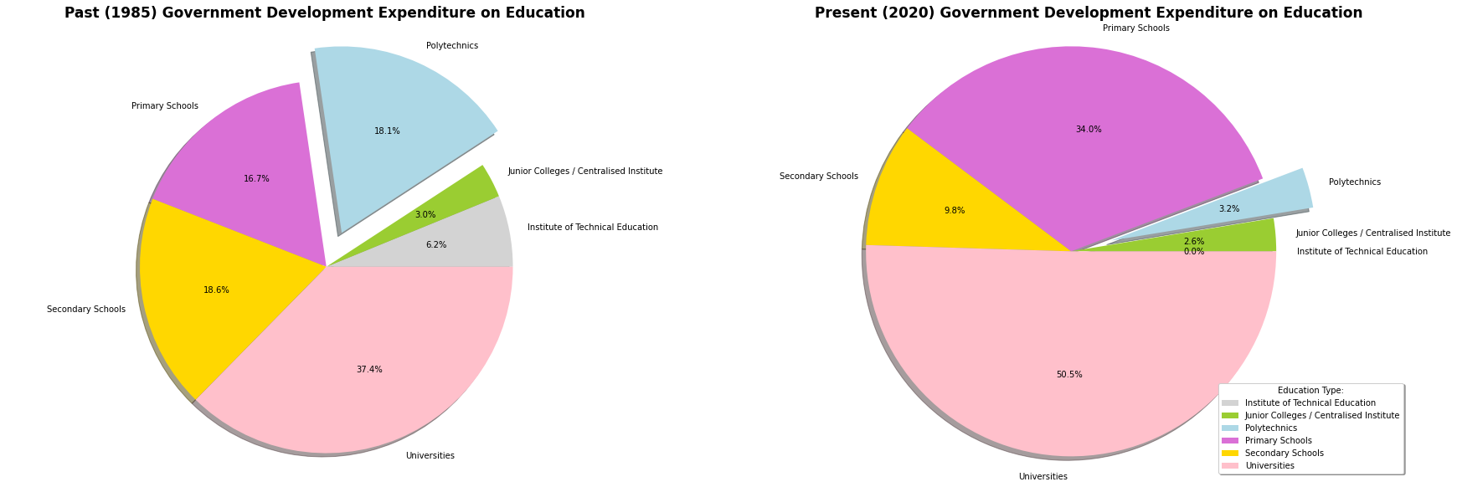
Insights gained
In 1985, Uni took up the most development expenditure (37.4%), while Junior Colleges/Centralised Institute took up the least expenditure (3.0%).
In 2020, Uni continue to take up the most expenditure (50.5%), while ITE now
takes up the least expenditure (0.0%).
It is seen that Primary schools and Universities are the education types that
received an increase in expenditure now as compared to the past.
The expenditure of Polytechnics decreased from 18.1% to 3.2%.

Slide 8
Insights gained
Thus, the pie charts have shown that the Singaporean government has spent money and resources to invest in the development of some of the education institutions in Singapore at some point of time.
This would contribute to the quantity and quality of resources provided in schools, which hence enhances the academic learning experience of students.
The decrease in expenditure, from 1985 to 2020, for Polytechnics, could just be due to the fact that Universities and Primary Schools are in a greater need, but does not mean that the facilities in Polytechnics have deteriorated.

Slide 9
02
Population of overweight students in different age groups
Has Singapore take steps to reduce the number of overweight students? (Improve the physical well-being of students)

Slide 10
The Nature of Dataset 2
YEAR
2009 to 2020
GENDER
Male or Female
AGE_GROUP
Primary 1 and equivalent age groups
Primary 5 and equivalent age groups
PER_10000_EXAMINED
Number of overweight students
Dataset did not need to be cleaned/wrangled as data was simple to read and understand, it was organised.

Slide 11
Analysis on Dataset 2:
In order to find out whether schools in Singapore has taken steps to reduce the number of overweight students, I have created a line chart and a bar chart to show the trend of overweight students (male vs female) over the years.
These are the steps I did to showcase the data through charts:
Imported the dataset by using np.genfromtxt().
Extracted the respective male and female data, followed by the respective age groups (line chart - “Primary 1 and equivalent age groups” & bar chart - “Primary 5 and equivalent age groups”), and lastly the number of overweight students (per 10,000 examined) of each age group.
Lastly, I used matplotlib to create a line chart and a bar chart, as well as add some features such as annotations to point out maximum/minimum points, grid to see the line charts easier, and legend to show which gender each line chart represents.

Slide 12
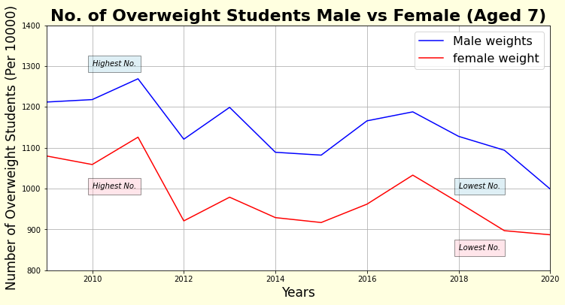
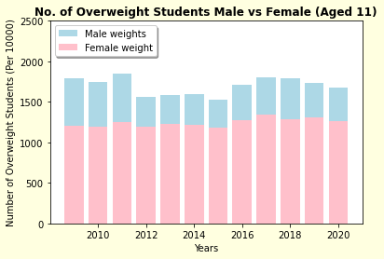
Insights Gained
Despite the fluctuations as seen from the line chart, it is still evident that the number of overweight students for both male and female (Aged 7), decreased over the years.
In addition, it is clear that there is a significantly greater number of male students than female who are overweight.
For the bar graph representing students Aged 11, despite the fluctuations, it is evident that the number of overweight males decreased over the years (number of overweight males in 2020 < that of 2009.)
However, the number of overweight females is seen to show a slight increase over the years.

Slide 13
Therefore, it is evident from the data analysis that the number of overweight students has generally decreased over the years.
Singapore has indeed taken steps to reduce the number of overweight students, proving that Singapore values the physical well-being of students.
The success could be due to the weekly physical education classes
MOE has included in the school curriculum.

Slide 14
Lasalle & NAFA
Intake, enrolment, graduates
03
My second daughter is interested in going to an art school. She would like to know what’s the the enrolment rate of art schools in Singapore like? How hard is it to get into an art school?

Slide 15
The Nature of Dataset 3
YEAR
2005 to 2020
SEX
MF (Male), F (Female)
YEAR
2005 to 2020
DIPLOMA_COURSE
Business & Administration, Design & Applied Arts, Fine & Applied Arts, Fine & Performing Arts, Media Production, Others
DIPLOMA_COURSE
Business & Administration, Design & Applied Arts, Fine & Performing Arts, Media Production
INTAKE
Intake of number of students into school
ENROLMENT
Number of students enrolled into school
ENROLMENT
Number of students enrolled into school
GRADUATES
Number of students who graduated
Old Dataset
New Dataset

Slide 16
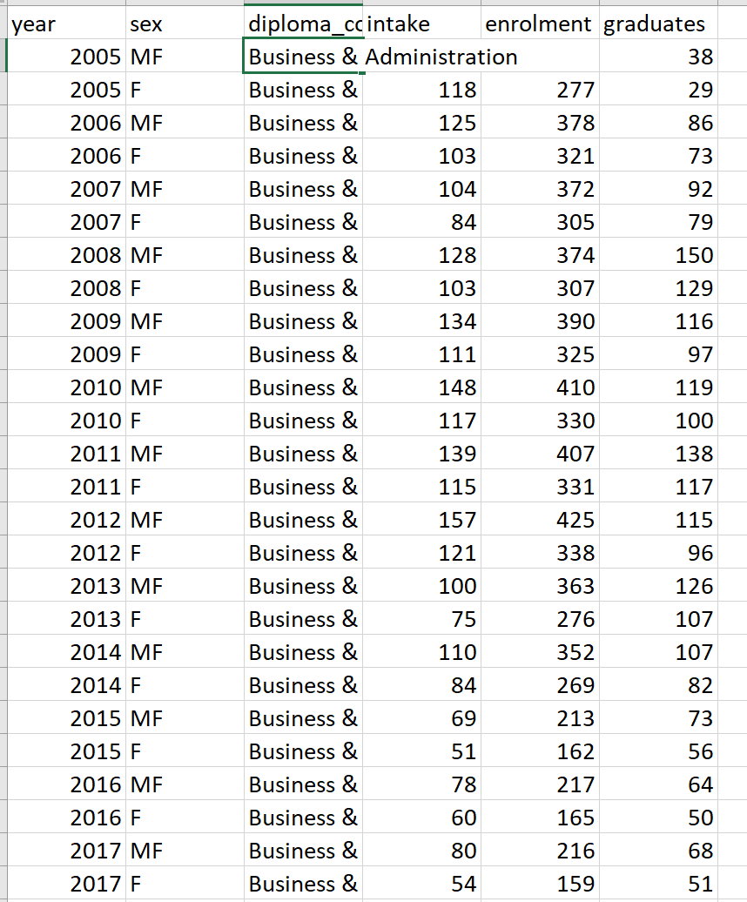
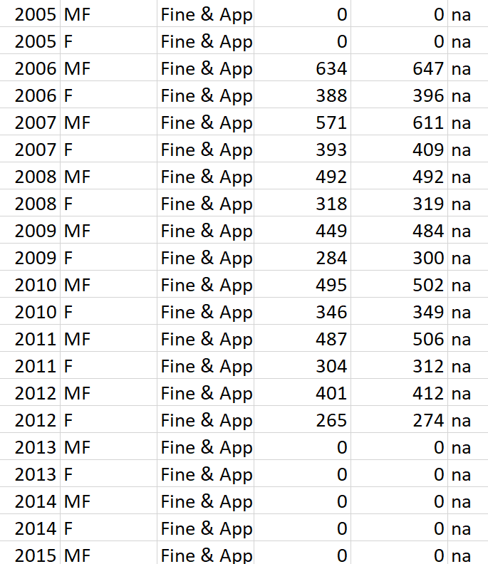
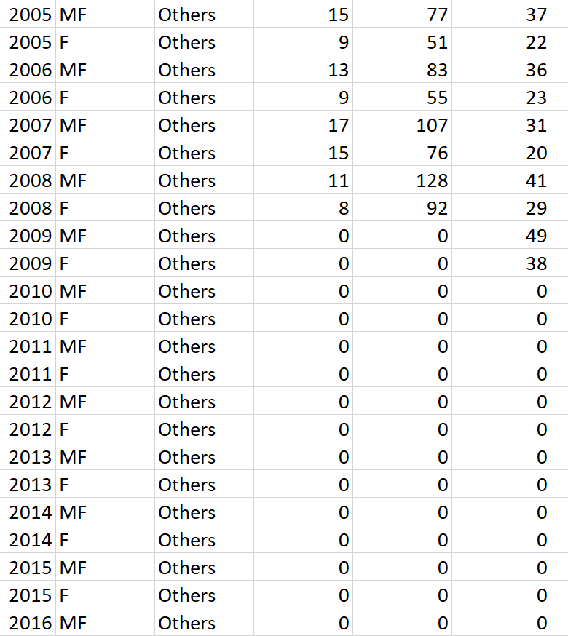
Cleaned/Wrangled Data by:
I used Microsoft Excel to edit the given dataset.
I deleted the data of Fine & Applied Arts and Others as they contained NA/null values.
Sex (gender), Intake and Graduates are also removed as they are not needed in my analysis.
I filtered the dataset such that it would be arranged by alphabetical order. This provided me with convenience in deleting the data that are irrelevant to my data analysis.

Slide 17
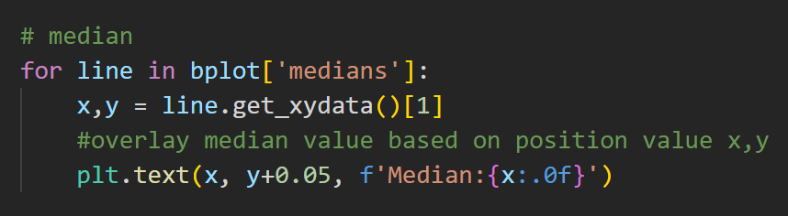
Analysis on Dataset 3:
In order to find out the enrolment of students into Lasalle/NAFA, I created a box plot to show the median number of enrolment.
These are the steps I did to showcase the data via the boxplots:
I imported the dataset, using np.genfromtxt().
I extracted the data of the 4 respective diploma courses using np.isin.
Then, I extracted the number of people enrolled for the 4 respective courses.
I used matplotlib to construct a box plot, and also add colours and labels to it.
To calculate median:

Slide 18
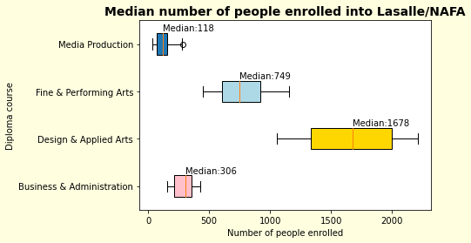
Insights gained
As seen from the boxplot, the median number of people enrolled into Lasalle/NAFA and their respective diploma courses ranges from 118-1678.
It is seen that Media Production has the lowest number of people enrolled while Design & Applied Arts has the greatest number of people enrolled.
This could suggest that Design & Applied Arts is the most popular course as compared to the other courses.
However, Media Production may be the course that is the most competitive to get in, as they only accept a small number of people as compared to other courses.

Slide 19
04
% of GCE O Level students who passed their 2nd language
Singapore has adopted the idea of bilingualism in their educations system. How good is the education system in fostering language literacy in students?

Slide 20
The Nature of Dataset 4
YEAR
1997 to 2020
RACE
Malay, Chinese, Indian, Others, Overall,
Dataset did not need to be cleaned/wrangled as data was simple to read and understand, it was organised.
PERCENTAGE_PASS_MTL
Percentage of students who passed Mother tongue.

Slide 21
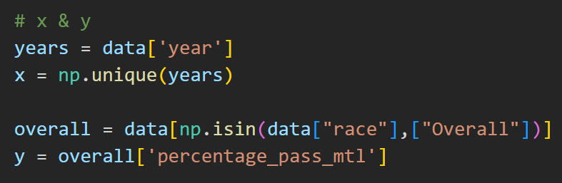
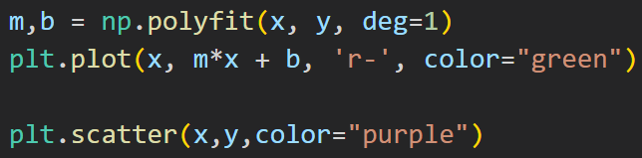
Analysis on Dataset 4:
In order to find out whether schools in Singapore have a good teaching system which effectively fosters bilingual students, I have created a scatter plot to show the percentage of O Level students who passed Mother tongue over the years.
These are the steps I did to showcase the data through scatter plot:
Imported the dataset, using np.genfromtxt()
Extracted the data for x-axis (year) and y-axis (% of students who passed mtl, race: overall)
Lastly, I constructed the scatter plot, as well as a best fit curve to better see the relationship between the percentage of passers and years.

Slide 22
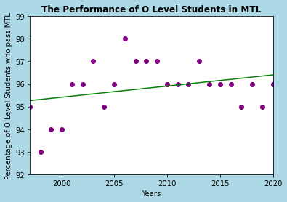
Insights Gained
As seen from the scatter plot, it is evident that the percentage of O Level Students who passed Mother tongue increased from 1997 to 2006, but then decreased slightly from 2006 to 2020.
However, after plotting a best fit line, it shows that the percentage of passers is concentrated between 95% to 97%.
Overall, the best fit line is seen to have a positive gradient, showing an increase in the percentage of passers from 1997 to 2020.
Hence, this tells me that Singapore has done a good job in fostering bilingualism in students.

Slide 23
In summary, I have concluded to move to Singapore.
Based on my data analysis, Singapore develops students holistically by providing fostering academic, intellectual, physical, language, and artistic education in them.

Slide 24
URL Of Datasets used
Government Development
Expenditure on Education
Overweight Students
01
02
03
Lasalle/NAFA enrolment
04
% of O Level Students
who passed MTL
https://data.gov.sg/dataset/government-development-expenditure-on-education
https://data.gov.sg/dataset/common-health-problems-of-students-examined-obesity-annual
https://data.gov.sg/dataset/lasalle-and-nafa-intake-enrolment-and-graduates
https://data.gov.sg/dataset/percentage-of-gce-o-level-students-who-passed-mother-tongue-language?view_id=67a722dc-7a84-4ab1-87f6-c4469bb9aa53&resource_id=ba5669ab-8e60-4d0c-b23a-8186b31c99d2

